Slide 1
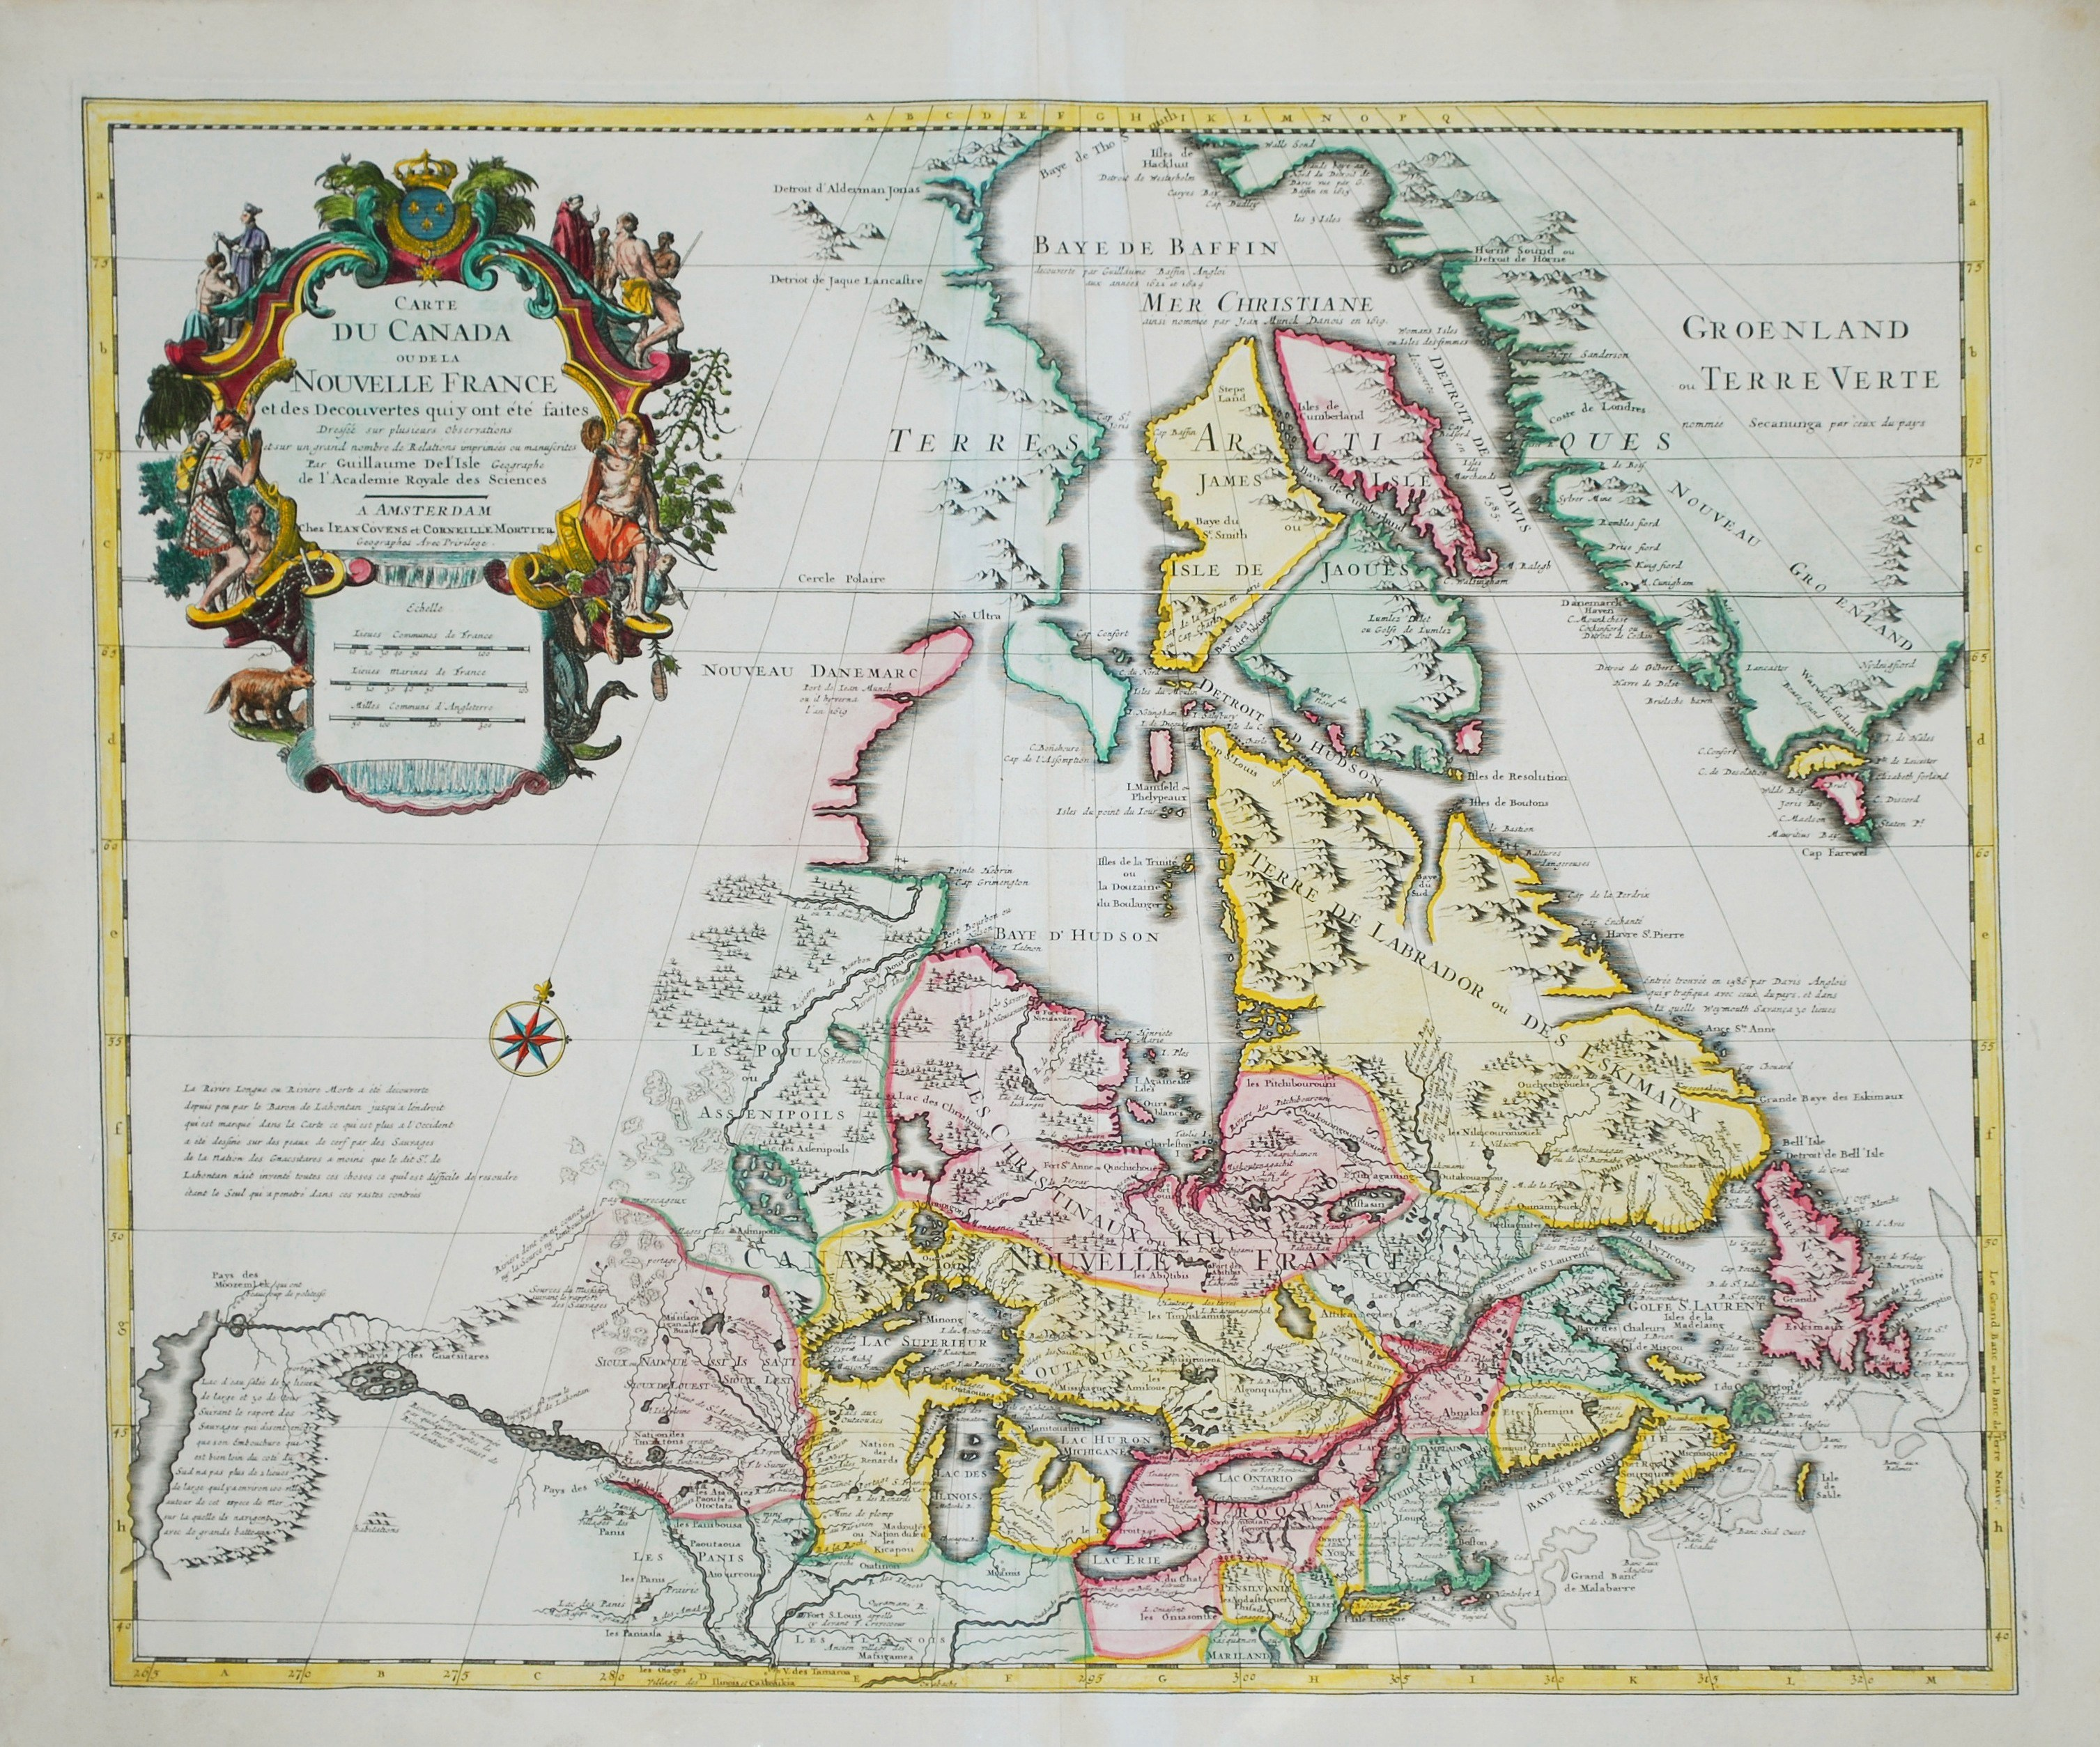
Colony to Confederacy

Slide 2
Targets

Slide 3
Questions to Ponder
Compare and contrast the impact of Jacksonian Democracy on US and CAN.
Compare and contrast Republicanism and Responsible Government
Compare and contrast US and CAN independence movements from Britain.
Compare and contrast US federalism and CAN confederation.
Who had the greater impact on formation of CAN government, UK or US?

Slide 4
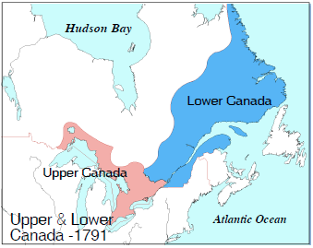
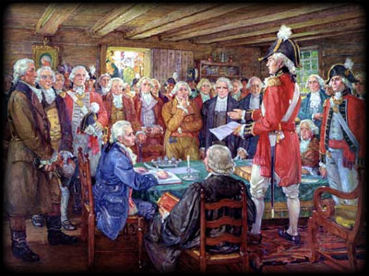
Origins
Quebec Act (1774)
Upper (British) and Lower (French) Canada (1791) divided at Ottawa River w/separate government
Aristocratic cliques rule through legislative assembly
Preservation of Anglican Church; Self-sufficient econ
Constitution of 1791

Slide 5
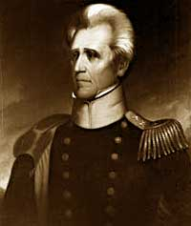

Reforms
Coincide with Jacksonian Democracy (1820s-1830s)
(Upper) Land redistribution & secularization of church
(Lower) Fought for right to preserve French culture; 2x population ruled by UK minority→ more representation
Conservative revolutionary reforms; agrarian reforms
Like
But in

Slide 6
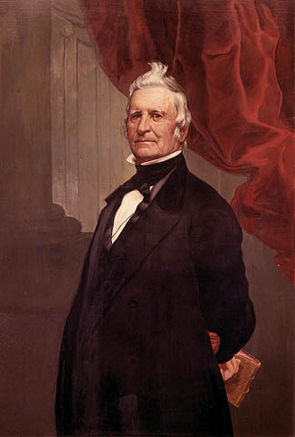
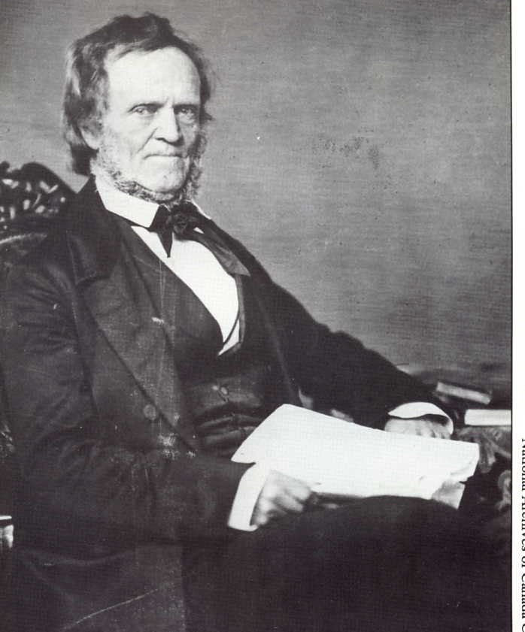
Transition to Republican Values
Upper – Mackenzie – wants elected legislature & executive council→ Yonge Street Rebellion→ failed
Lower – Papineau – calls for revenue bills to originate in representative assemblies→ troops put down rebellion with no reform
Mackenzie
Papineau

Slide 7
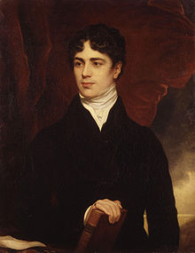
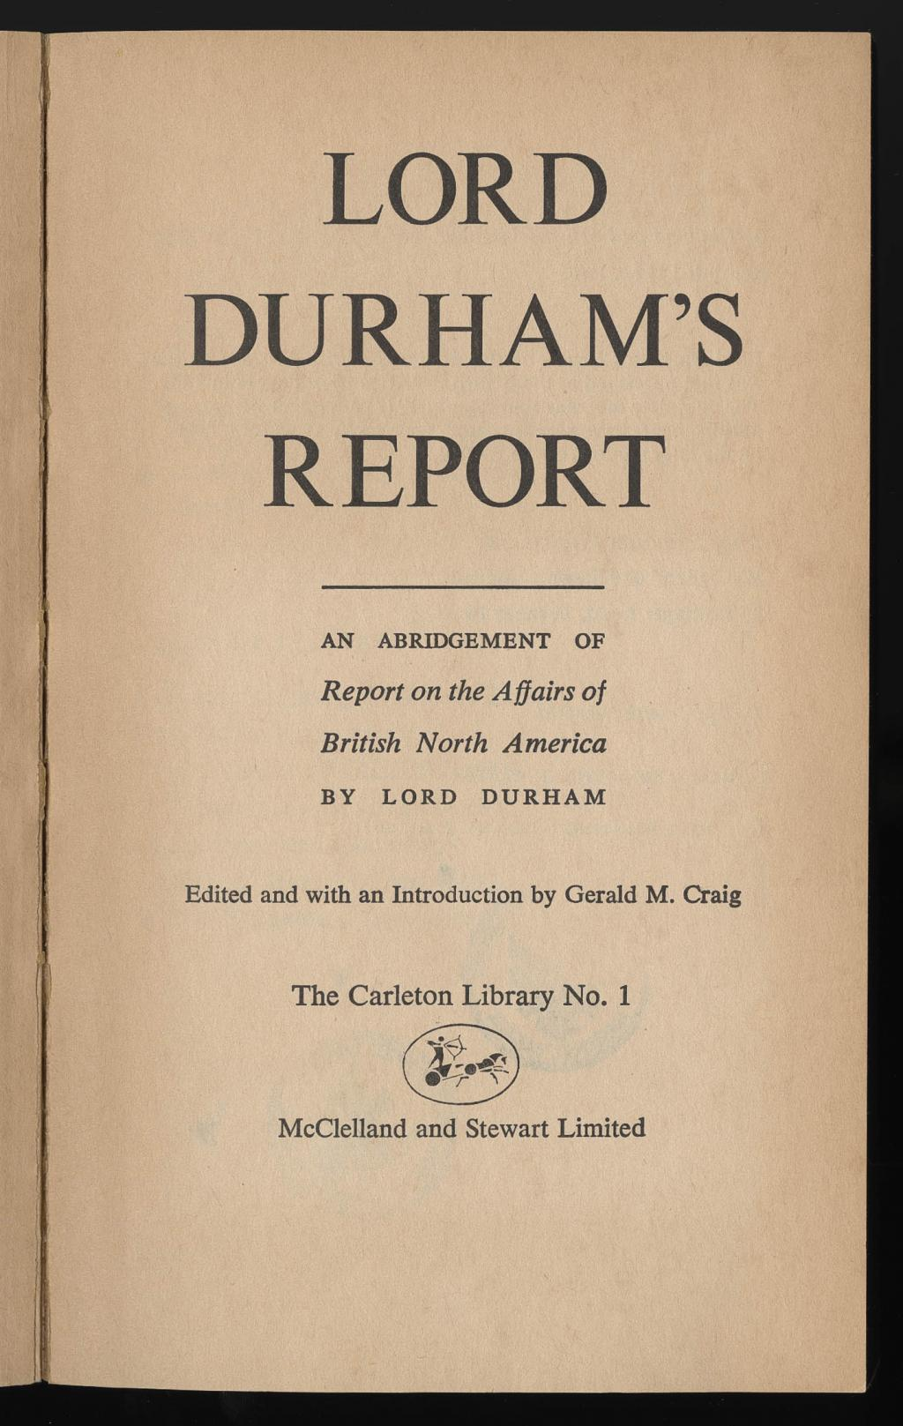
Lord Durham’s Report (1839)
Friction between Legislative Assembly and appointed Leg. Councils
Lower Canada – Backwards people
Solutions:
Reunite CAN w/common assembly and rep by pop.
Responsible gov. based on UK Cabinet system
Separate jurisdiction over imperial and local matters

Slide 8
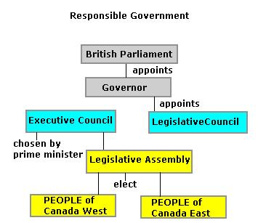
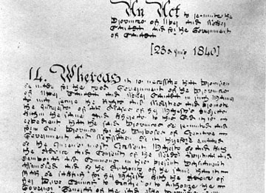
Results
Act of Union (1840) – United legislative system
Weak system, but expanded electorate for Leg. Assembly
Gov. appoints members of Leg. Council
Responsible Gov. (1848) – Parliamentary leg.
LA appoints LC→ Cabinet

Slide 9
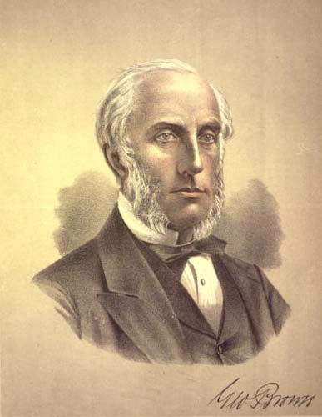
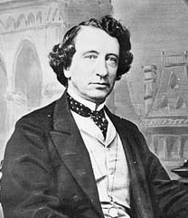
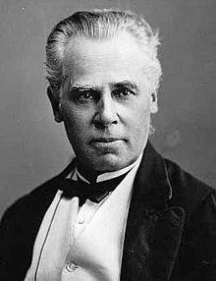
Confederation
George Brown and the Clear Grits – English, Canada West republicanism – universal suffrage, free trade, secret ballot, representation by population
John Macdonald – Liberal-Conservative – united moderate English/Ontarian conservatives→ win election of 1857
George Cartier – Parti Bleus – Quebecois, Moderate conservative; provincial power, but willing to have federal system
Great Coalition (1864) – Brown and Mac federation
Brown
Mac
Cartier

Slide 10
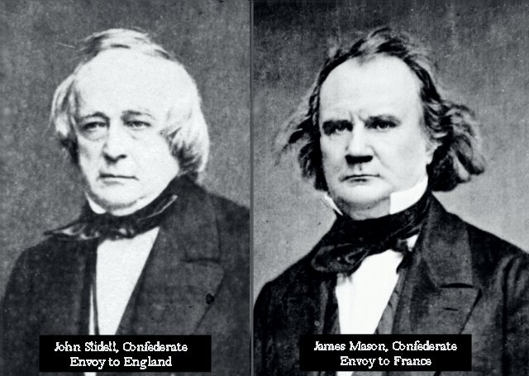
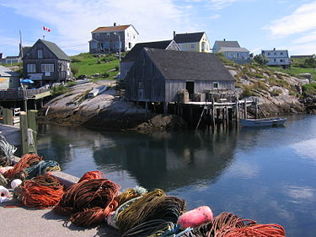
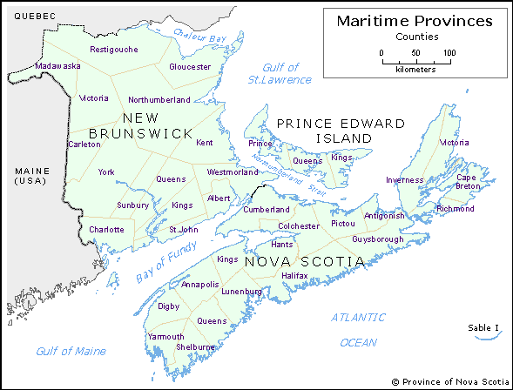
Conflict & US Impact
Maritimes – Don’t want to join union because of rep. issue & want to trade w/ NEng
Trent Affair (1861) – US Confederates hijacked by Union en route to UK to gain recognition→
– 14k British troops occupy BNA→ who pays for BNA defense?→
Militia Bill (1862) – CAN raises militia→ voted down by Fr. CAN→ UK want CAN to pay for their own defense; CAN→ NO
Slidell and Mason
Maritime Town

Slide 11
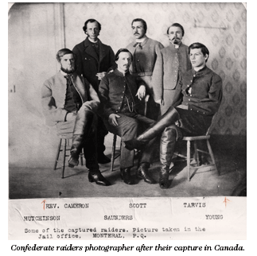
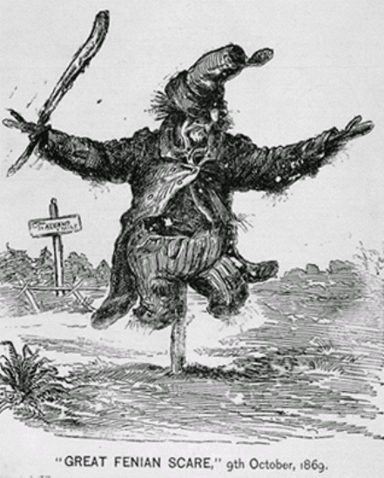
St. Alban’s Raid (1864) – CSA raiders rob VT banks→ return to CAN & not punished→
US ends Reciprocity & Rush-Bagot (1817) →
Armed ships to Great Lakes; generals given order to pursue raiders into CAN→
Further question of who defends CAN vs. US?
Fenian Scare (1866) – Disorganized Irish-Americans attack New Brunswick→ CANs assumed ties to Irish ind. Movements from UK→ Unity would aid defense→

Slide 12
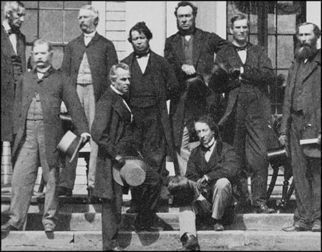
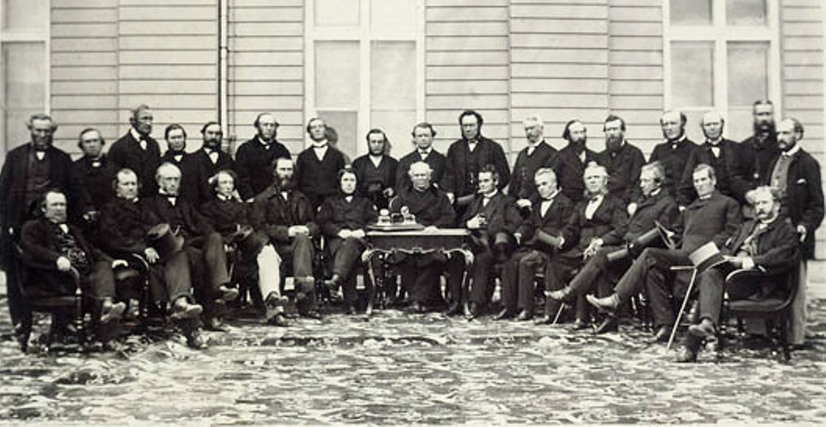
Road to Independence
Charlottetown Conference (1864) – General consensus on federal union
Quebec Conference (1864) – Wrote Constitution→
Retain ties w/UK + federal gov & bicameral leg.
Conservatism dominant – industrialization & expansion, NOT Enlightenment
Macdonald gets his strong Parliament/central gov
Cartier gets his provincial gov w/property, religion, education control
Brown gets his “rep by pop” in Commons
Intercontinental RR – Needed to satisfy Maritimes and balance power w/ CAN West (US cancellation of Reciprocity helps)
C-Town
Quebec

Slide 13
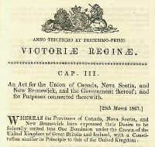
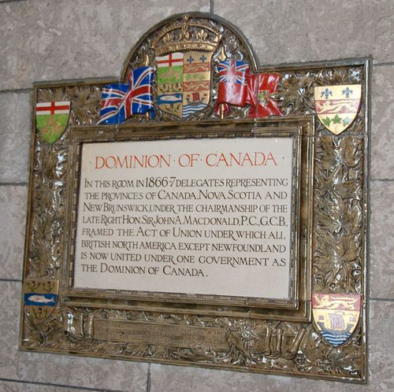
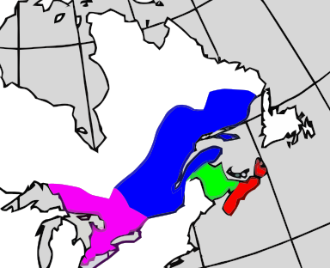

London Conference
Goal: Draw up leg. for CAN Confederation→ British North America Act signed 3/29/1867→
Dominion of Canada born 7/1/1867
Four Provinces – Ontario, Quebec, New Brunswick, Nova Scotia→ Manitoba (’70), BC (’71), PEI (’73)
Macdonald is first PM

Slide 14
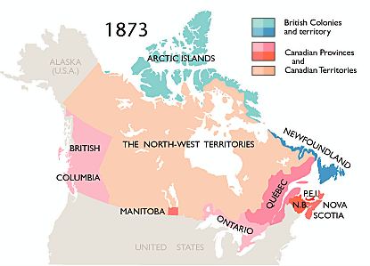

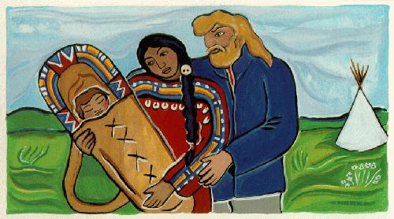
Growing Pains (1869)
CAN buys NWT from Hudson Bay Co. & grows 6x
Louis Riel – Bloodless coup of Metis (half FRA/NAm) during power transition to stop land surveying by CAN→
Created BoR & tried to unite colony→
Compromise pending when Riel executes Thos. Scott→
Riel faced CAN troops and was executed→
Impact: CAN gov leads Western development, NOT private interests like US.
Metis Family

Slide 15
Federal Government
To Central Gov– trade, commerce, defense, levy tax, appoint provincial lieutenant-governors; declare provincial laws unconstitutional
To Provinces – Property and civil rights, language, religion, natural resources
Bicameral Leg. – Commons – rep by pop; Senate – appointed by federal gov for life (conservative check on Commons)
Executive – Modeled on UK Cabinet & appointed by Maj. Party Leader
Judicial – All judges above County appointed by Central Gov
Criminal law in fed courts; Civil law determined by Central Gov
Revenue – Customs/Taxes filtered through Central Gov→ 80c per capita to each province

Slide 16
Constitutional Monarchy
Power limited by Constitution
In the event CAN could not resolve a dispute on its own, Judicial Committee of the Privy Council (JCPC) in UK did and commonly championed provincial rights.
Prorogue Power – Only monarch can completely disband Par and call for new elections

Slide 17
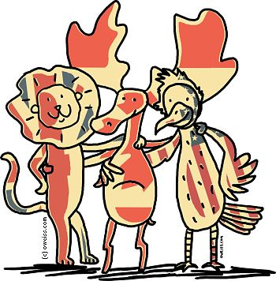
Britain vs. US Influence
US – Federalism, Senate, rep by pop
UK – Not republican, no separation of powers (cabinet comes from leg. branch), weaker Senate like Lords, crown heads gov, responsible par system

